Slide 1
Data Science with SQL Server 2016 and R Oliver Frost
Saturday 29th April 2017

Slide 2
Thank you!

Slide 3
Today’s session
The R and SQL Server “stack”
Why R? UPDATE: Python!
DEMO – R inside SQL Server 2016:
Setting up
Executing scripts
DEMO – Data Science with RevoScaleR:
What are the libraries for?
Explore, summarise and plot data
Predictive modelling and big data

Slide 4



Introductions and Background
Cognitive Neuroscience graduate (2015)
Microsoft SQL Server 2012, 2014 and 2016
Microsoft R, open R and Python
Hadoop, Cassandra, Spark
LinkedIn: https://www.linkedin.com/in/olliefrost/
Twitter: @ConsolidataLtd

Slide 5
Relational vs Non-relational

Slide 6


Relational databases overview
Advantages of relational:
Efficient, structured storage.
Keeps data consistent.
Complex querying language for retrieving data, updating, inserting, deleting.
Used for:
Modelling relationships between entities.
Reporting and decision-making.

Slide 7

Relational and NoSQL together
What can R do that SQL can’t?
Great for statistical analyses, machine learning, handling unstructured data.
Becoming a more general programming language.
Daily workload with R and SQL Server:
Structured, modelled data lives and is updated in SQL. Changes logged.
R is for ad hoc analyses on clean files, reshaping data files or reading non-flat files.
Quick to import, do a business analysis piece on, clean up and import, all in memory.

Slide 8
Microsoft and Data Science

Slide 9

What is R?
R is an open-source programming language, developed by academics and statisticians.
High level language, easy to learn.
Short development cycles.
Written in C, Fortran and R, so performance can be very fast.
Over 6,000 libraries available to use on CRAN.
Now used for cleaning data, ETL, data visualisation, maths, audio and visual analysis, machine learning etc.

Slide 10


Microsoft R
Formerly known as Revolution R
Provides Math Kernel Libraries (MKLs) capable of multithreading – makes R code generally faster.
MS offers three basic products:
R Open – a base
R Client – restricted use of proprietary functions.
R Server – unlimited scalability

Slide 11
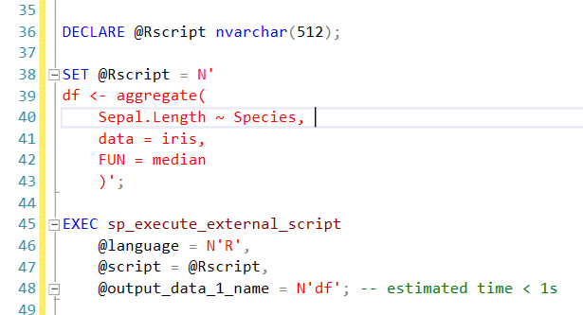
What’s new inside SQL Server 2016?
JSON support.
R and Microsoft R Server integration.
Other features:
Temporal tables.
Row masking and encryption.
Integration with Hadoop, Spark, Teradata.

Slide 12

UPDATE: Python in SQL Server 2017
No need to move data around.
Embed Python scripts inside T-SQL stored procedures.
You will therefore be able to deploy machine learning and AI applications inside SQL Server 2017.
Manage R and Python scripts in the same location.
90k+ libraries – majority of which should be compatible.

Slide 13
Data Science in Microsoft R Server

Slide 14

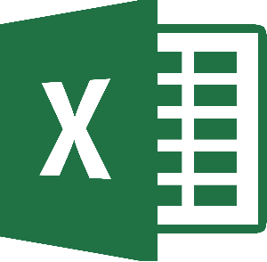







Slide 15




What do businesses use these tools for?
Building “data pipelines”:
New data is coming in all the time.
Needs to be extracted, transformed and loaded.
Needs to be fast.

Slide 16
Azure ML
Microsoft is constantly developing its Azure platform for data science and machine learning.
Tools:
Azure ML – a “drag and drop” tool for building data science pipelines.
Microsoft SQL Server 2016 with R Services – run R scripts as SQL procedures.
Microsoft R Server.
You also have Python support.
Build pipelines “without a PhD in statistics.”

Slide 17
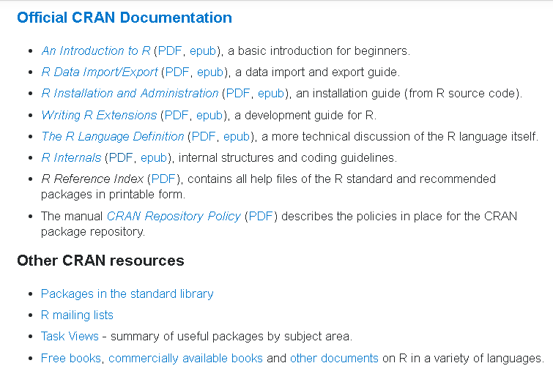
Resources
Stack Overflow:
Documentation Topics
Resources, books, tutorials
Consolidata:
R tutorial series
‘swirl’ library in R:
learn R inside R!

Slide 18
DEMOS

